Slide 1

Snow Ice cream website design
Abdillah Mzee Khatib

Slide 2
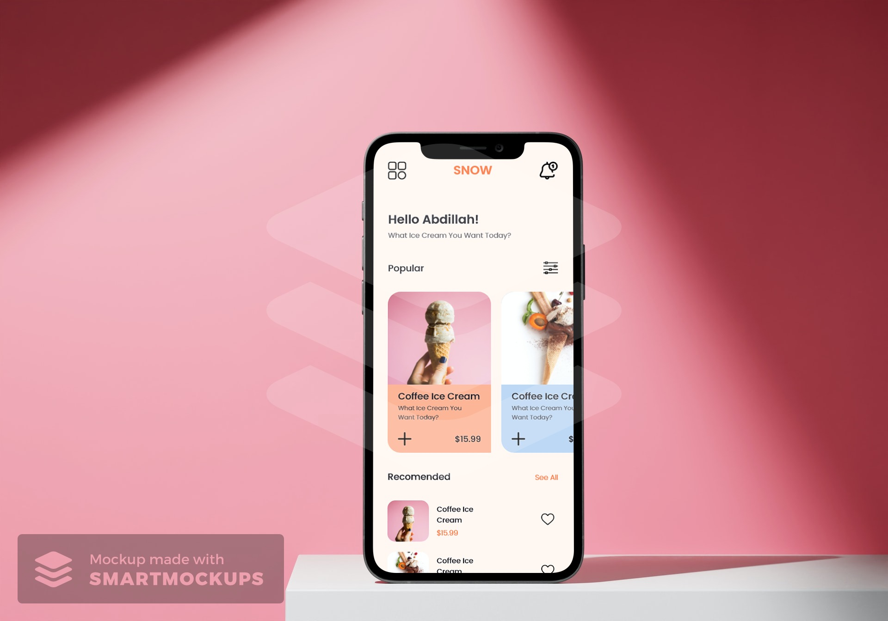
Forecast evaluation
The outcome:
Snow Ice cream is a known Ice cream distributors found in all cities of a town area. Snow Ice cream is trying to give out services which is good and Ice cream with different flavour. They offer a really goog price for everyone to afford. Snow Ice cream targets customers who are neighborhood to their stores..
Preview of selected polished designs.
Forecast time:
August 2021 to August 2022

Slide 3
Forecast evaluation
The challenge:
To those neighbor who have lack of ice cream stores in their city and young children who likely to eat ice cream.
The objective:
Construct a website which will help those in need to reach out location easily to get the product.

Slide 4
Forecast evaluation
My part:
A designer who is designing a website for Snow Ice cream from the idea of location detection.
Duties:
Preparing an observation, hand paper drawing, analog blueprint, first and final stage pictures, preparing usefulness learning.

Slide 5
Customer testing
Person
Challenges revelations
Customer tour charts
Perceptioning
the customers

Slide 6
Customer testing: resume
I was the one who came up with idea of testing our website to the customers to get their compliments which will help us to see if its helpful to them or there some features needed to corrected either to remove them or keep, we got information through our target members who were elders and young children.

Slide 7
Customer testing: struggling keys
1
2
3
Location
Accountability
vision
Looking the place where stores are located was very hard for them.
The customers met diffuculties on reaching out the website to do their staff.
The brightness was too much for them to handle so they find it hard to use website.

Slide 8
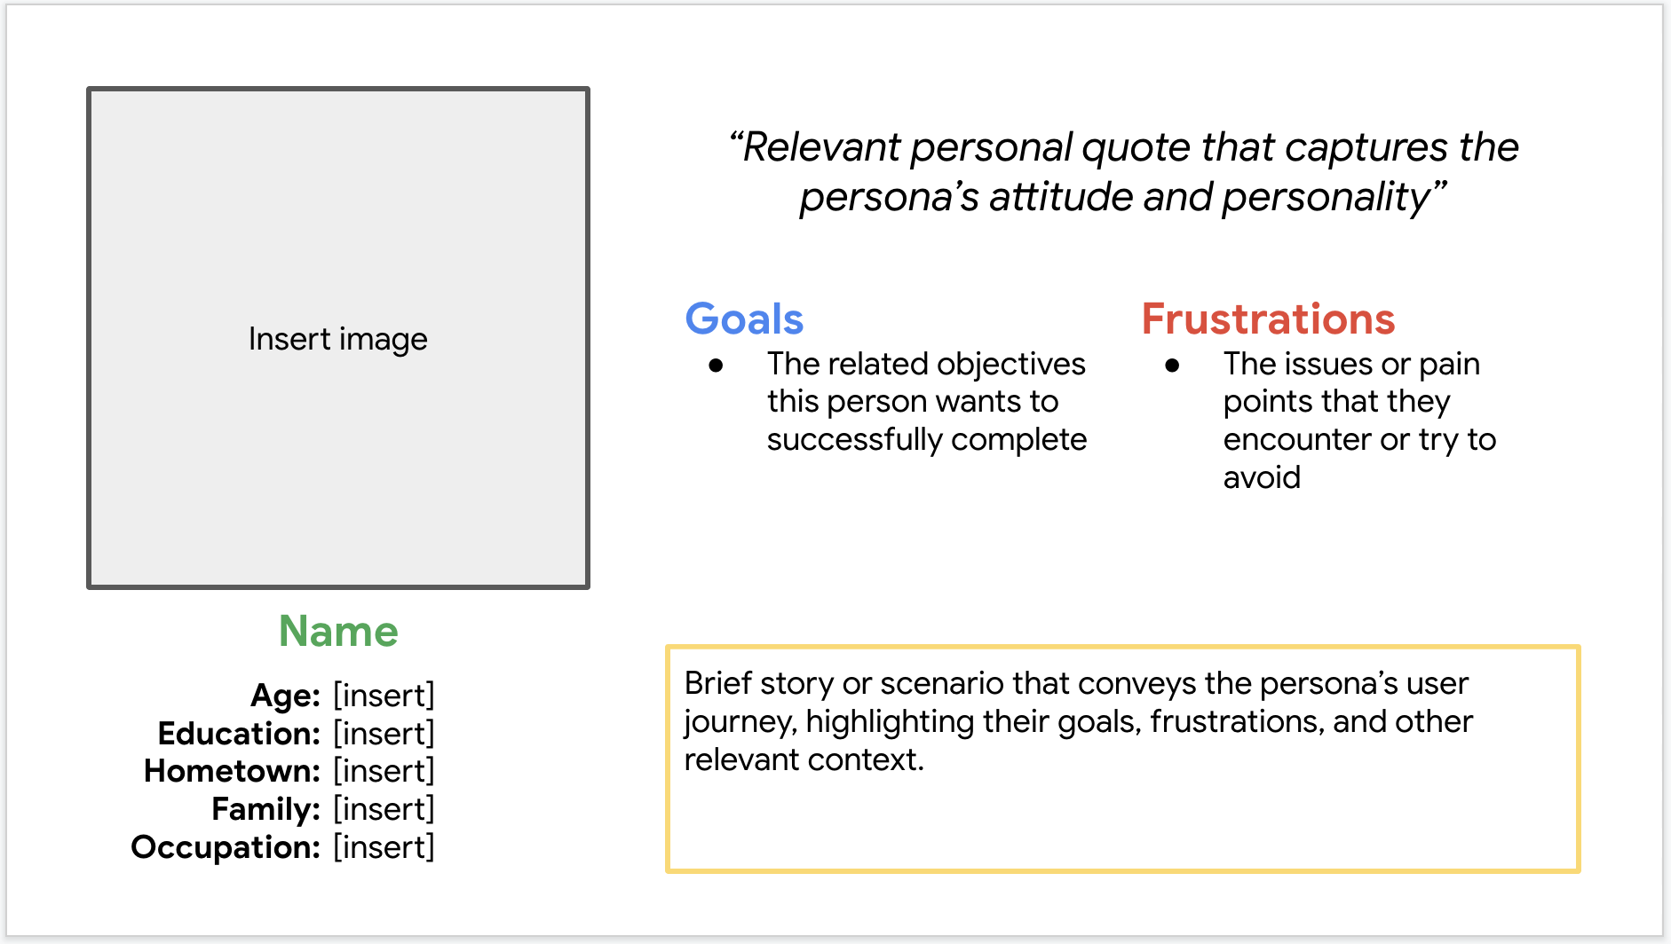
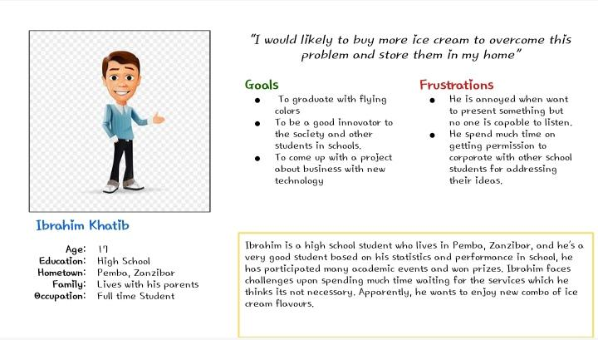
Person: Ibrahim Khatib
Challenge revelation:
Ibrahim Khatib is a high school student who has not enjoy the combo of cream for long now.

Slide 9
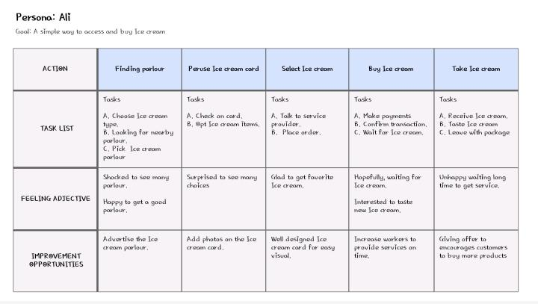
Customer tour chart
Chart of one of our customer tour shows how it can help for customers have access to the Snow Ice cream website.

Slide 10
Analog blueprint
Online blueprint
First stage pictures
Usefulness learnings
Beginning
the plan

Slide 11
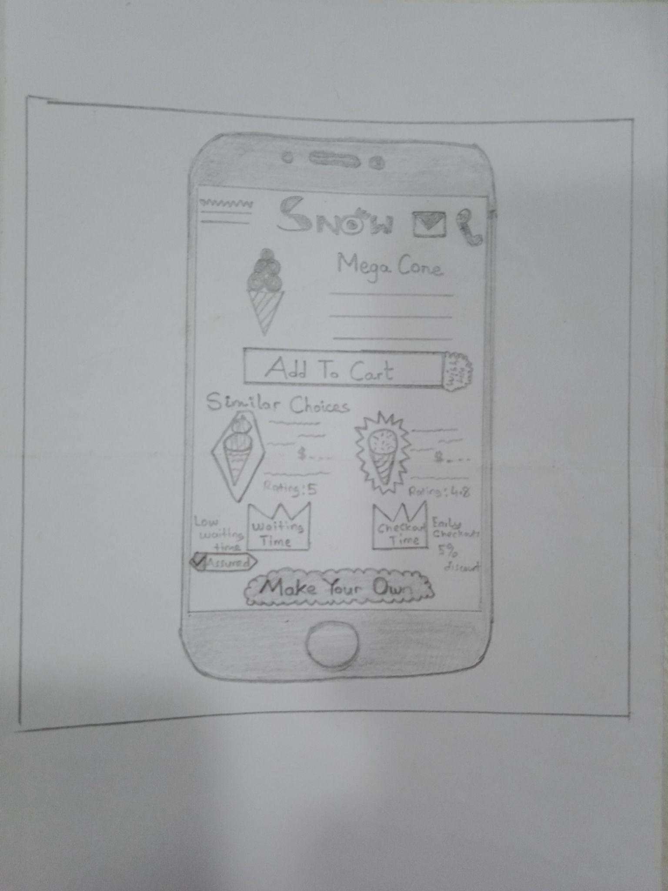
Analog blueprint
The hand drawing which show the whole plan of designing process

Slide 12
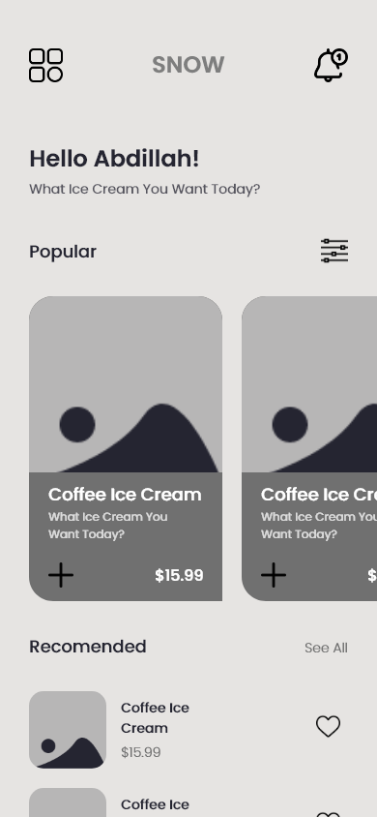
Online blueprint
Some features displays on the home face.
This picture shows the first stage of design with some features helpful to customers
Features gives customers more choices

Slide 13
Online blueprint
Simple access layouts help to read easily on the screen..
The animation layouts which sometimes gives direction where to begin or proceed

Slide 14
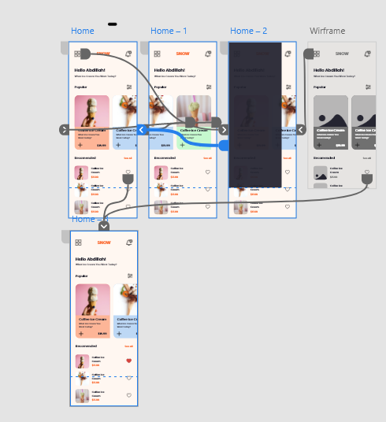
First stage pictures
As it can be seen, was my work that constructed the first stage pictures and connect according to the users flows which was helped by observation made during launch up the product.

Slide 15
Usefulness learning: feedback results
Actually, we had lack of information about our website from users so, as a team leader took decision on preparing usefulness learning so that we can get comments as can be seen below which was in two phases.
Step 1 feedback results
Step 2 feedback results
1
Customers prefers to access location easily
1
There are alot of adds which repeatedly displays on the screen
2
Customers prefers more buy options
2
Making a new website is so hard
3
Customers prefers online payments option

Slide 16
Rebuilding
the design
SmartMockups
Final stage pictures
Reflections

Slide 17

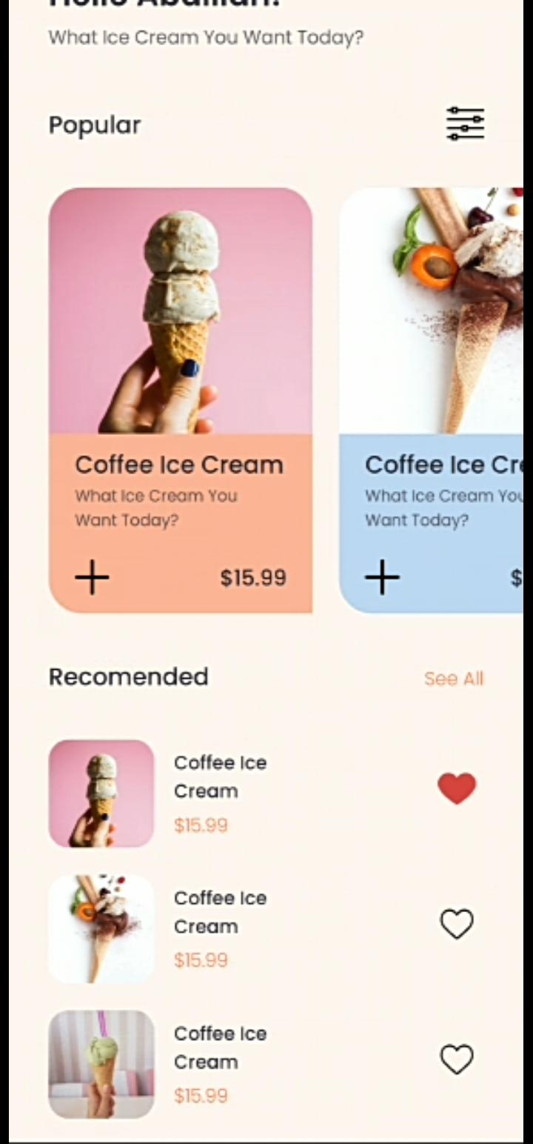
SmartMockups
Prior to usefulness learning
Later of usefulness learning
In the first design of final stage pictures or process not likely to good due results of misssing some importants features according to the users, the ice cream or put on cart, but after the usefulness learning, some features were maintained.

Slide 18
SmartMockups
Prior to usefulness learning
Later of usefulness learning
The second usefulness learning launch was annoyed with the checklist flow, some improvement need to be made to solve the problem.

Slide 19
SmartMockups
Main mockup screen for display
Main mockup screen for display

Slide 20
Final stage pictures
The final stage pictures which shows completely flow of the website operations

Slide 21
Availability reflections
1
2
3
The website should have maximum features so everyone can see clearly
Apply colored layouts to help them make animation easier.
Simple language used everyone can understand

Slide 22
Keep moving
Noted points
Following paces

Slide 23
Noted points
Benefits:
The website become a major impact for them realizing that the problem has been solved.
The noted words from results:
“The website made it so simple to reach out any store! He will really utilize this website as to reach a nearest store and get his favorite ice cream”.
What I studied:
When designing the Snow Ice cream website, I studied that the first ideas for the website are only starting point of the process. Usefulness learning and fellow desiners comments motivated each steps of the website’s designs.

Slide 24
Following paces
1
2
Take another measure steps to solve all problem occurred during observation.
Take time to test again customer observation to examine any new places of needed to.

Slide 25
Insert a few sentences summarizing the next steps you would take with this project and why. Feel free to organize next steps in a bullet point list.
Attachment information
Thanks each one of you , if you want to get in touch, catch me through.
Email: akhatib@gitam.in

